Slide 1



UNIT 2
Lesson 8
IN &OUT OF FASHION
Part 4

Slide 2
What can you remember about Alicia Riggs?
BRAINSTORMING
CLOTHES
How important are clothes to you?
Why do people wear designer clothes?
Who can afford them?
What do you think about school uniforms?
What is good/bad about them?

Slide 3
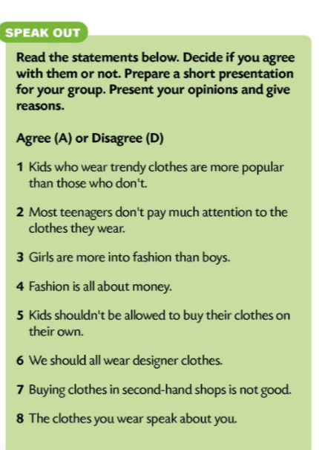
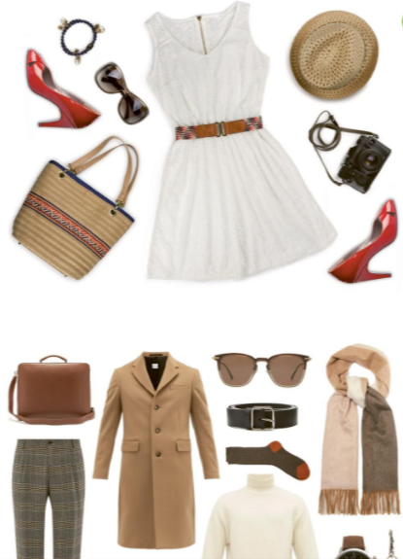

Slide 4
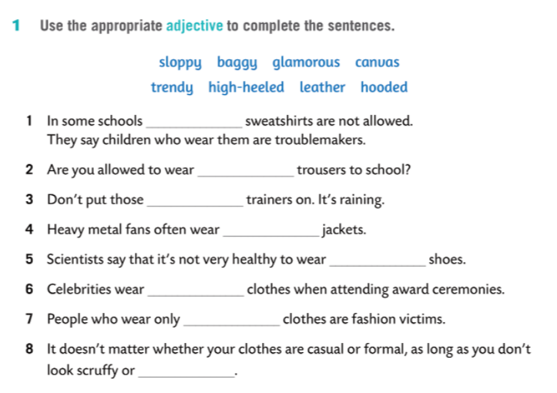
cotton
hooded
baggy
cotton
leather
high-heeled
glamorous
trendy
sloppy

Slide 5
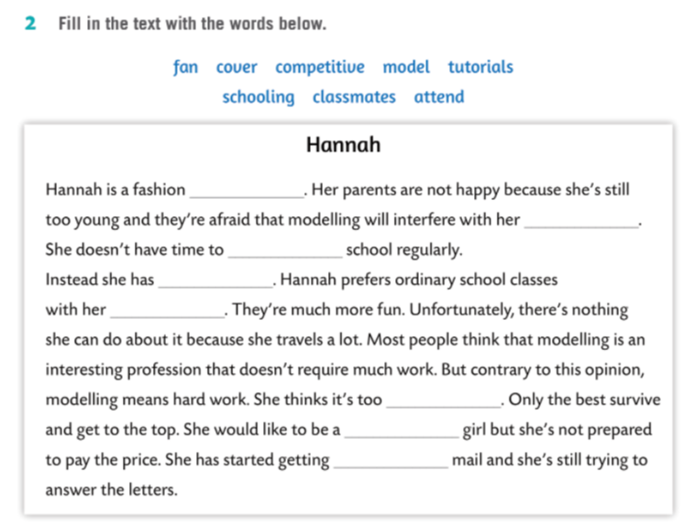
model
schooling
attend
tutorials
classmates
competitive
cover
fan

Slide 6
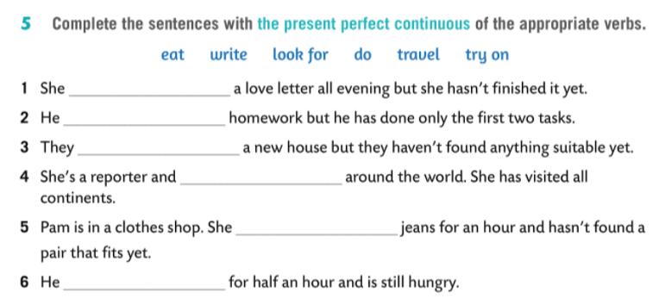

‘s been writing
‘s been doing
‘ve been looking for
has been travelling
‘s been trying on
‘s been eating

